Slide 1

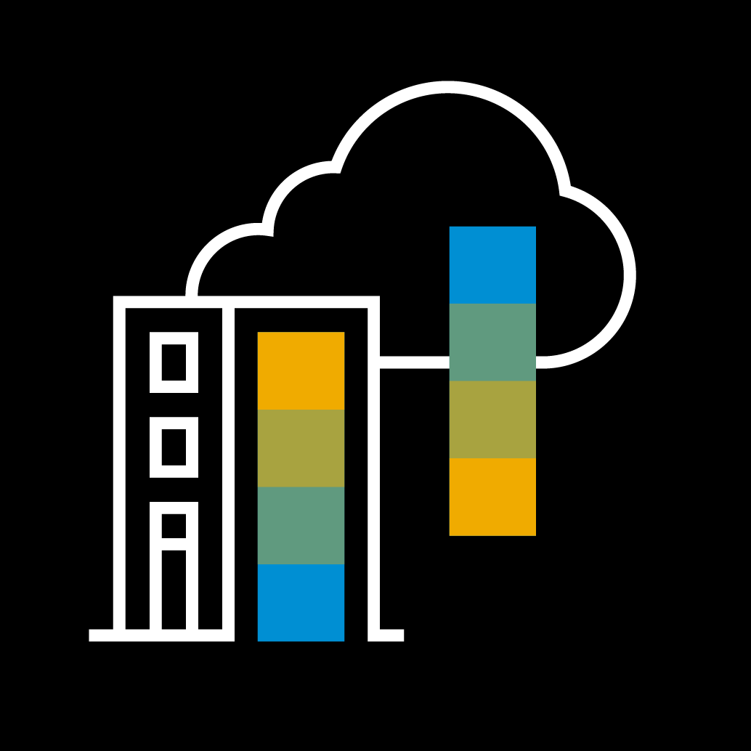
DITA Landscape – One Strike DITA Build refactoring & migration to Google Cloud DITA CMS migration to Converged Cloud
Youssef Bennani
Last update: August 30th , 2022

Slide 2
One Strike DITA Overview Plan
DITA Build Migration project
DITA CMS Migration project
Current SAP DITA Landscape

Slide 3
One Strike DITA Overview Plan DITA Landscape = DITA CMS + DITA Build
Homepage
One Strike Program

Slide 4
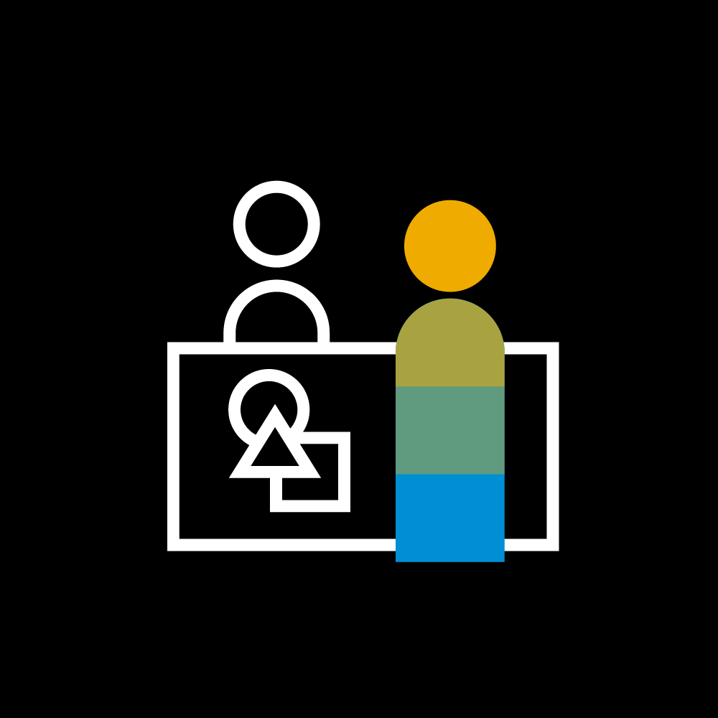
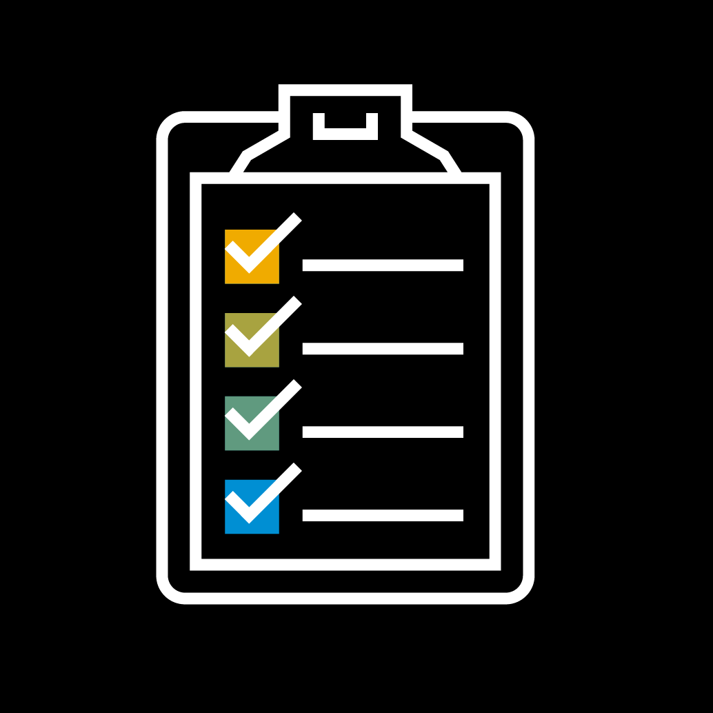
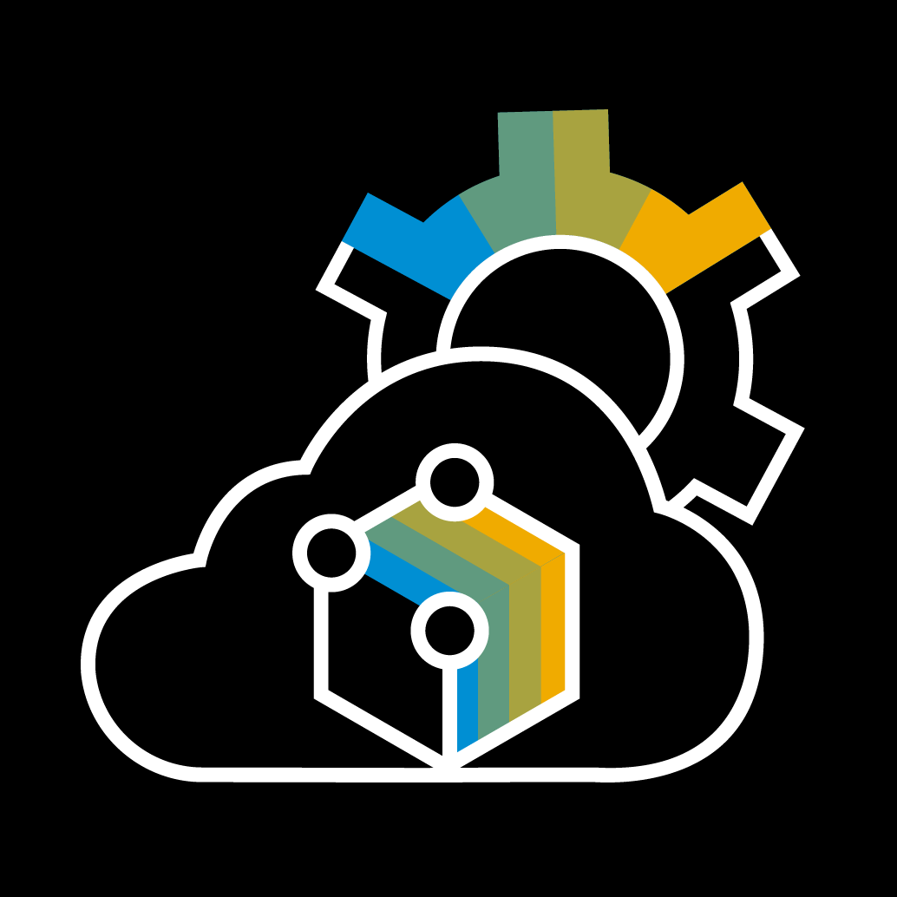

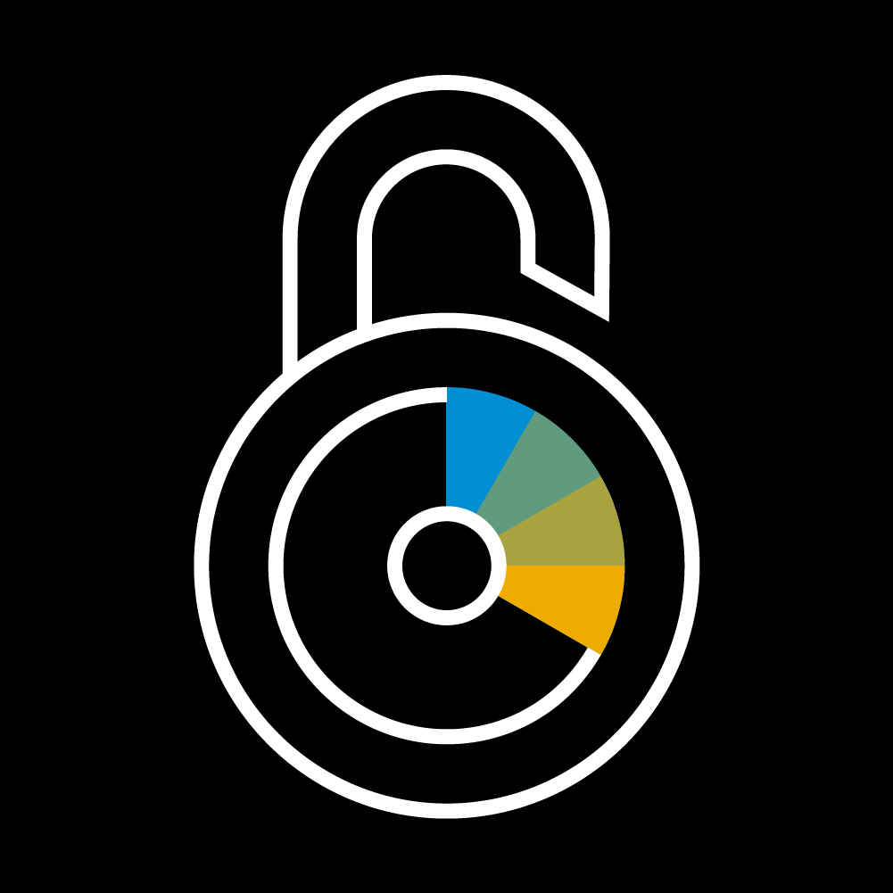



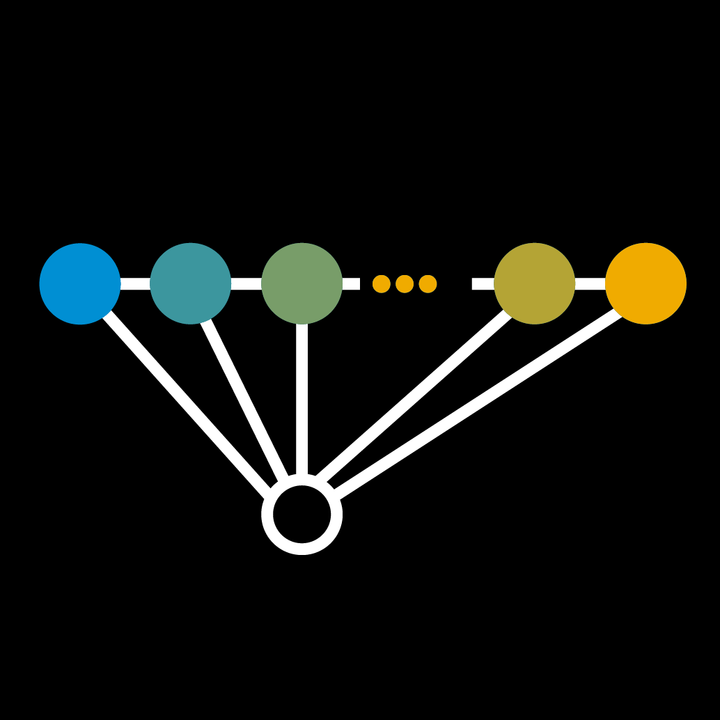
DITA Build @GCP
Done (in CI mode) | In progress | Planned
Architecture & technical impl.
Objective
DITA Build system renovated and migrated to Google Cloud by August 2022 (One Strike)
Motivations | Promise
Replace current proprietary, monolithic on-premise build solution with modern, more scalable and flexible solution
Improve performance with faster publishing cycles
Improve availability and resiliency with world-class infrastructure and support from Google
Reduce cost of infrastructure, operations and maintenance with pay-per-use model, Serverless infrastructure and automation
Make it CMS agnostic, supporting multiple CMSs (IXIASOFT, GitHub, …)
Make it our platform for innovation to deliver new scenarios faster
Migration
DITA Build system is migrating to GCP public cloud where we consume serverless resources from GCP Frankfurt region (Europe West 3)
GitHub scenario
DITA CCMS scenario
UX design/Mock-up
DITA CCMS scenario
Microservice architecture on GCP public cloud - Frankfurt
Build Dashboard
Serverless with fully managed infrastructure
E2E functional testing GitHub scenario
Agnostic (IXIASOFT / DITA, GitHub / Markdown)
E2E functional testing DITA CCMS scenario
Piloting & enablement
Container based components
Cloud Architecture
E2E Performance testing
Hacking Simulation (HASI)
Security concept
Migration process
Threat modeling
Validation
Security & DPP
GDPR
Credentials mgmt. (HashiCorp vault)
Compliant with SAP security hardening rules for GCP
O2O linking
DITA Build @GCP
Audit logs forwarded to the Central SIEM (vulnerability detection)
Feature flag
DITA scenario extended features
Data merge
Infrastructure Support & SLAs
“Least privilege” principle
PDF generation
Delta build | multi-langue | fall back | Copy-to
GCP Infra support 24x7 - Google
Sideras Infra support 24x7 - GLDS
DITA OT frmwk migration
DITA scenario core features
Development pipelines (Automation)
Monitoring 24x7 - GLDS
Metadata handling
Monitoring dashboards (Grafana)
IXIASOFT delta fetch
Recommended actions/procedures
GitHub scenario
Deployment pipelines (Automation)
Standard compliant CI/CD pipeline (JaaS, hyperspace)
E2E micro-service impl. (GitHub/MD → UACP)
Code quality, Security, code vulnerability, open source IP
Triggering Continuous Deployment for validated components
OKRs & Backlog | One Strike Q-Gate dashboard
DITA OT frmwk extension
Landscape deployment
GCP Infrastructure deployment (TERRAFORM) – Infrastructure as code
Disaster recovery
Continuous Deployment to Sideras run-time (TERRAFORM)
Secure by design automation
Continuous Deployment to GCP run-time (TERRAFORM) + Rollback
Notes:
Inner source model

Slide 5
DITA CCMS @Converged Cloud
Done (in CI mode) | In progress | Planned
Translation
DITA CCMS
Translation
DITA CCMS
Architecture on CC
Objective
DITA CCMS system refactored and migrated to Converged Cloud by August 2022 (One Strike)
Motivations | Promise
Improve performance by switching to newer and powerful infrastructure
Improve availability, stability and resiliency by migrating to new technology stack (Converged Cloud, Linux) and addressing existing architecture bottlenecks
Improve total cost of ownership by reducing cost of infrastructure, operations and maintenance as result of automation and containerization
Migration
DITA CCMS system is migrating to SAP Converged Cloud within Frankfurt 4 (EU-DE-2).
Resources are created in ONE single CC project (GLDS-DITA) and deployed in two availability zones
Post migration & decommissioning
POCs: RDP, CCMS Web, On-prem like
E2E functional testing
Piloting & enablement
Cloud Architecture & POCs
E2E Performance testing
Hacking Simulation (HASI)
Security concept
Migration process
Validation
Security & DPP
GDPR
Credentials mgmt. (HashiCorp vault)
Compliant with SAP security hardening rules
XTM Infra migration
DITA CCMS @CC
Audit logs forwarded to the Central SIEM (vulnerability detection)
Legacy translation
Translation Migration
Infrastructure Support & SLAs
RDP Infrastructure migration & refactoring
Sideras Infra support 24x7 - GLDS
CCMS Web
DITA CCMS Migration
Monitoring 24x7 - GLDS
TEXTML migration to CC / Linux
Monitoring dashboards (Dynatrace)
Recommended actions/procedures
Deployment pipelines (Automation)
OKRs & Backlog | One Strike Q-Gate dashboard
App Intallers
Sideras deployment pipeline (TERRAFORM) – Infrastructure as code
Disaster recovery
Secure by design
Notes:
Inner source model

Slide 6
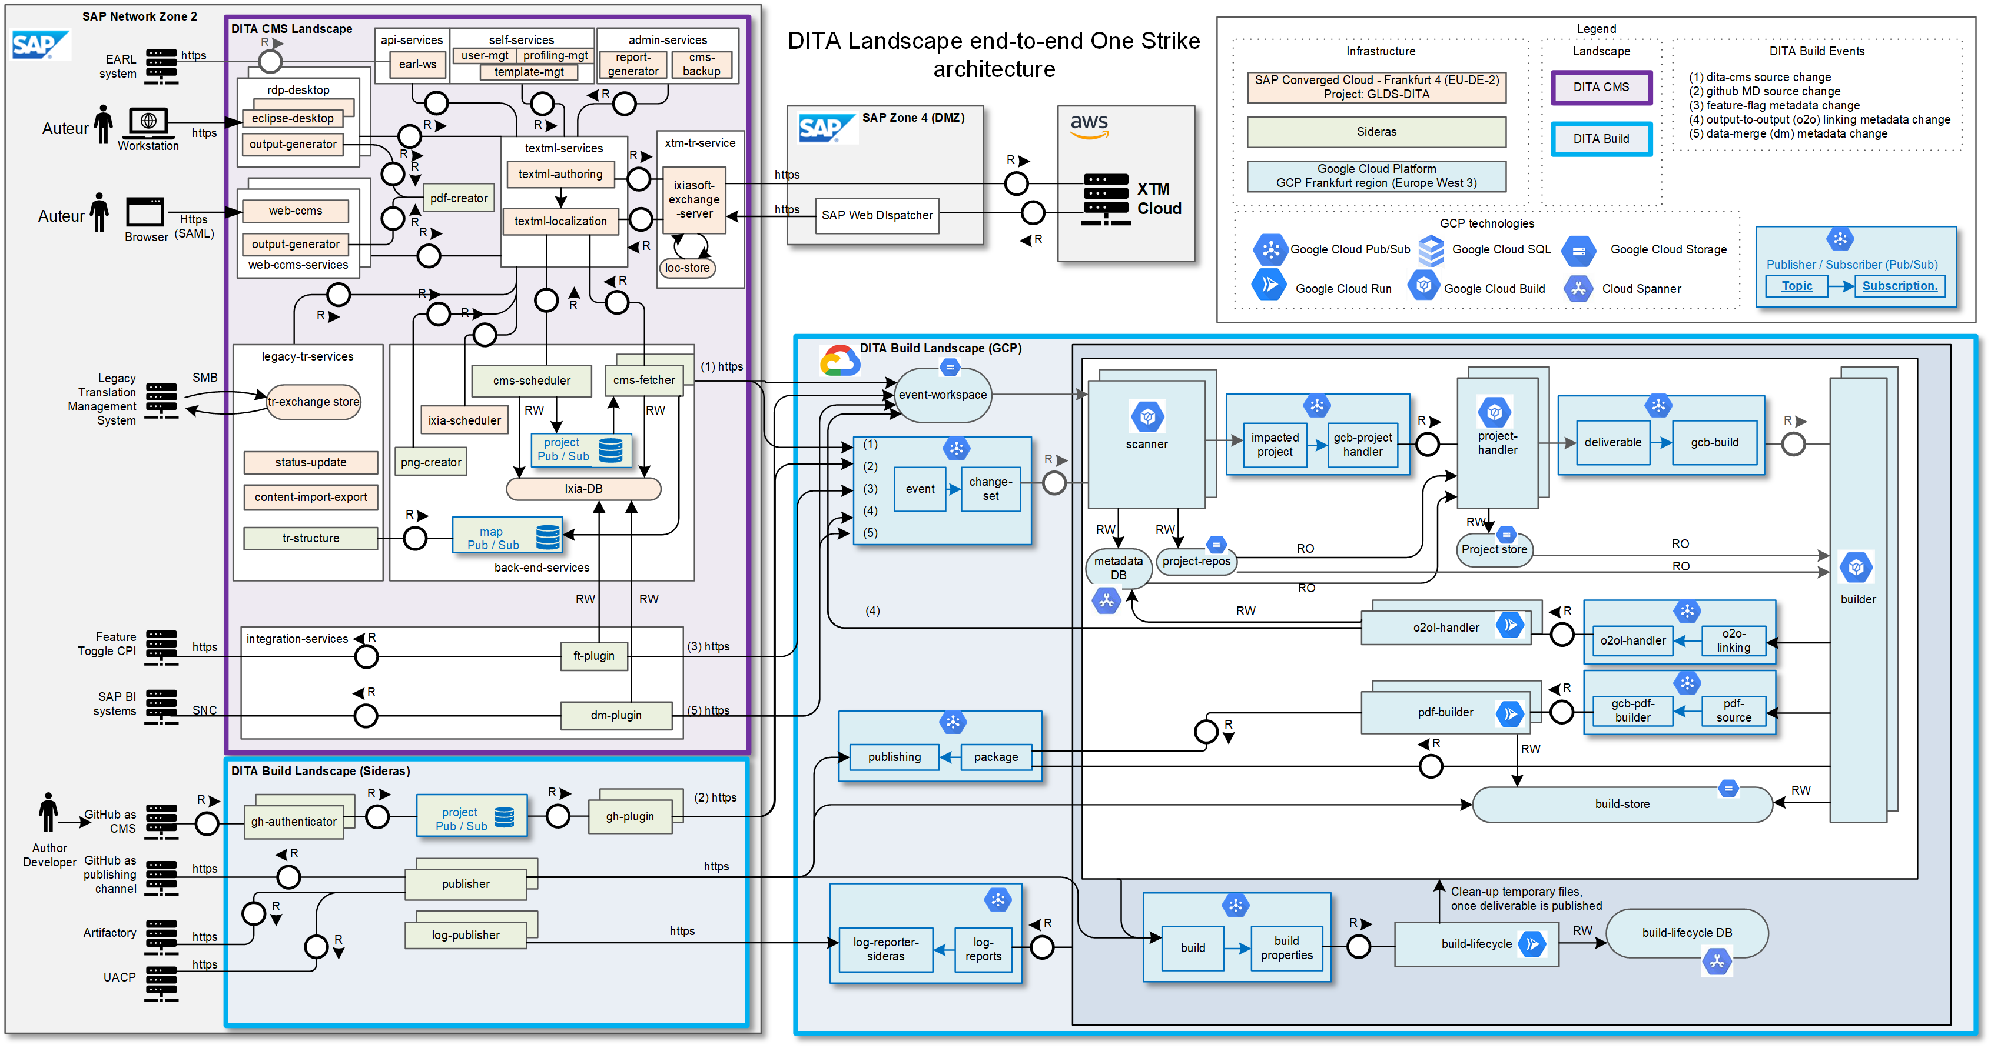
Back to home page
See
DITA Landscape architecture Overview | SAP Help Portal

Slide 7
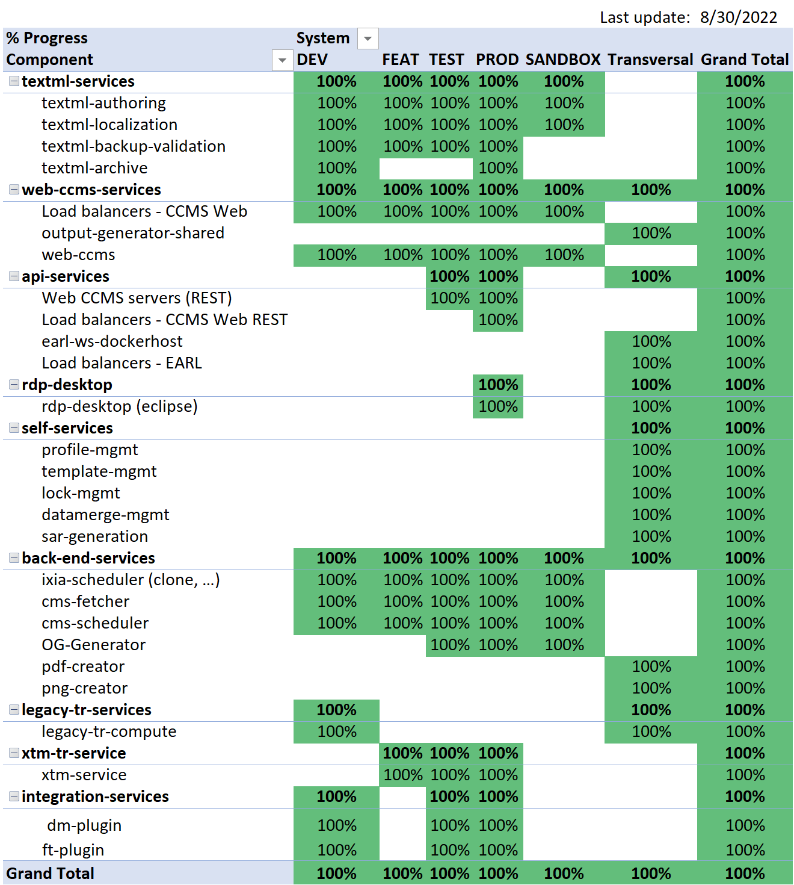
Back to home page
DITA CMS Migration plan
Migration approach
No big bang!
Iterative approach where we migrate component by component on our various systems FEAT, TEST PROD…etc.
For each component,
if development/refactoring is required it’s done in DEV.
Once completed, it’s migrated to FEAT for feature validation
Once completed, it’s migrated to TEST for end-to-end testing and performance testing
Once completed, it’s migrated to PROD
Avoid disruption to end-users
No action expected from end-users
No change into the end-user support process
Continued Infrastructure support process
GLDS operates our new CC Infrastructure
During the transition, GLDS operates Legacy and new Infrastructure until the end of the migration where Legacy infrastructure is decommissioned
Source - See ‘Migration progress dashboard’ tab

Slide 8
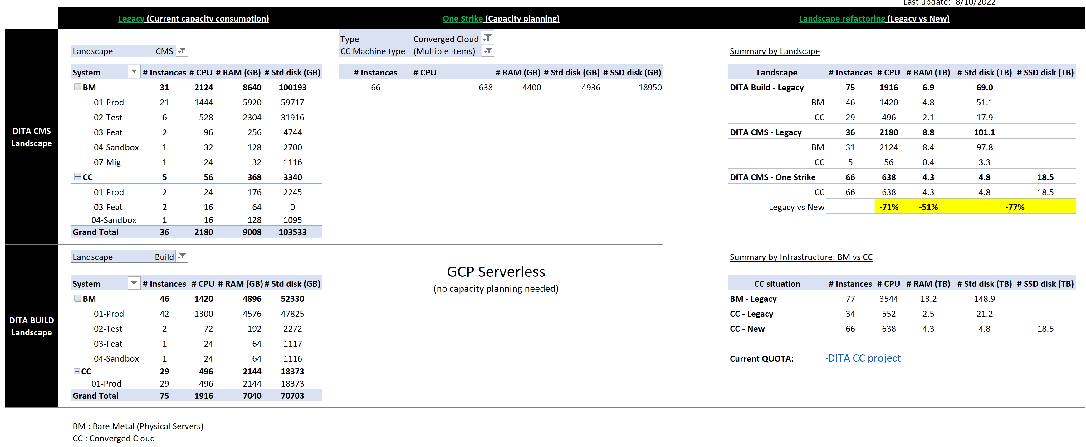
Back to home page
DITA CMS Capacity plan
Source - See ‘Capacity planning Dashboard’ tab

Slide 9

Back to home page
DITA Landscape (CMS & Build) Cost plan
See DITA Landscape Billing details
Legacy part (in blue) will be at zero once all Legacy servers are LoB decommissioned and removed from billing

Slide 10
Back to home page
Legacy DITA Landscape (CMS & Build) Decommission plan
Source

Slide 11
Back to home page
DITA Build final migration progress
Source

Slide 12
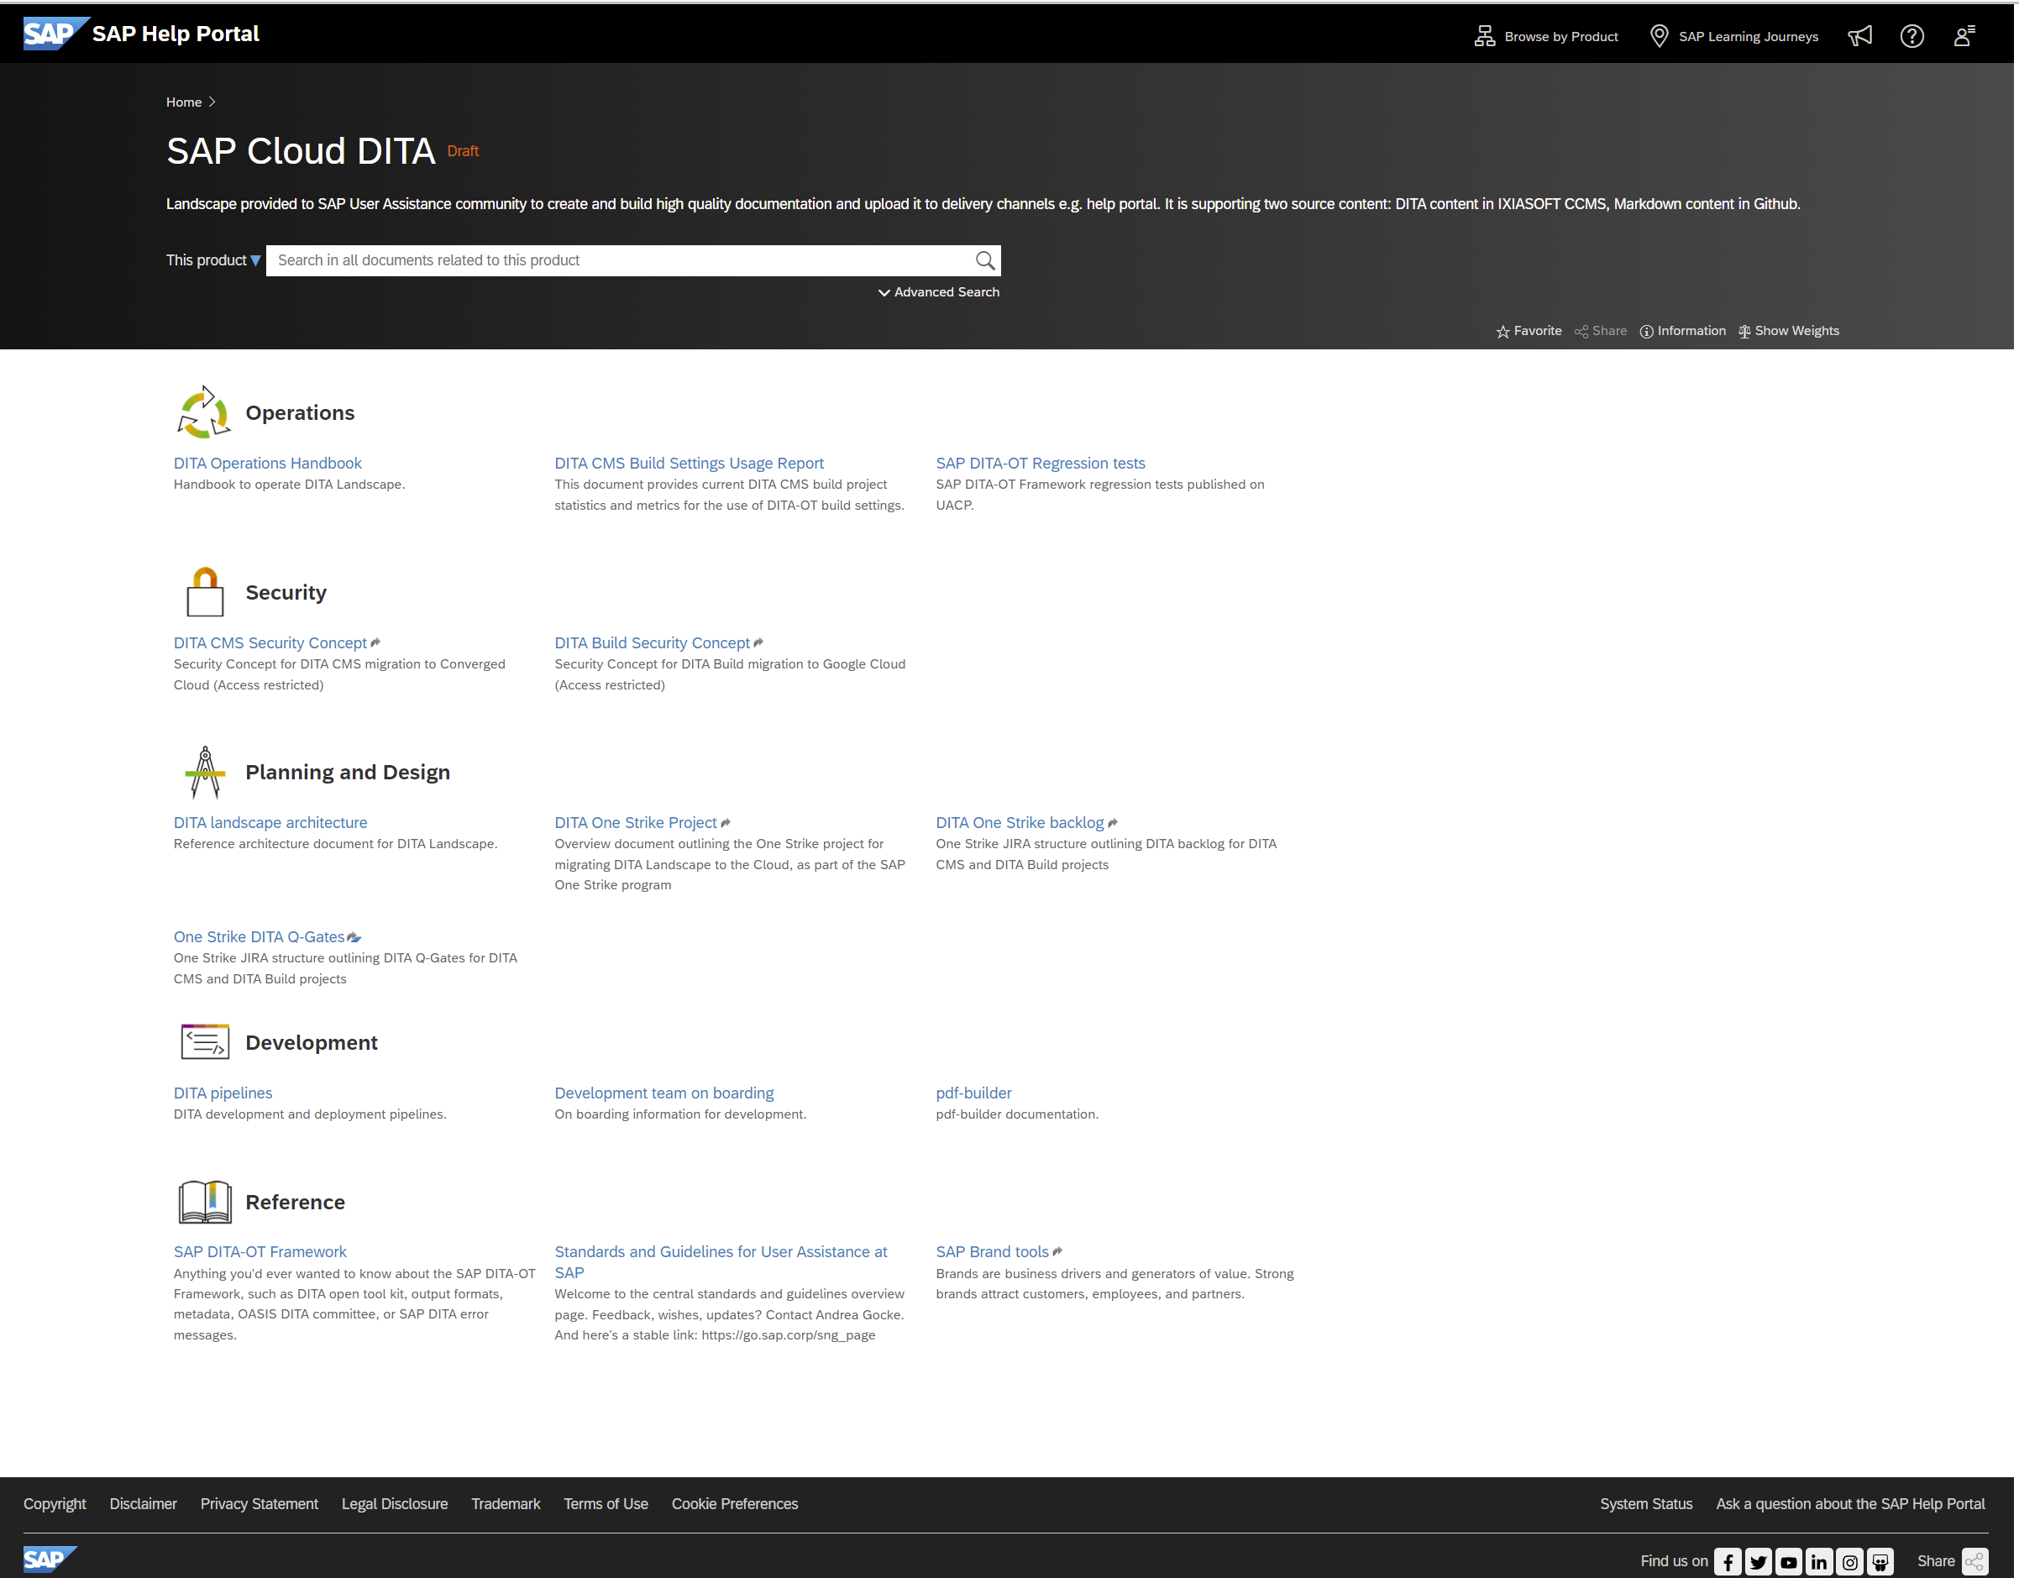
Back to home page
DITA Landscape (CMS & Build) documentation
See SAP Cloud DITA documentation
Content in GitHub / Markdown
Produced by new DITA Build @GCP

Slide 13
DITA Build Migration project
Homepage

Slide 14
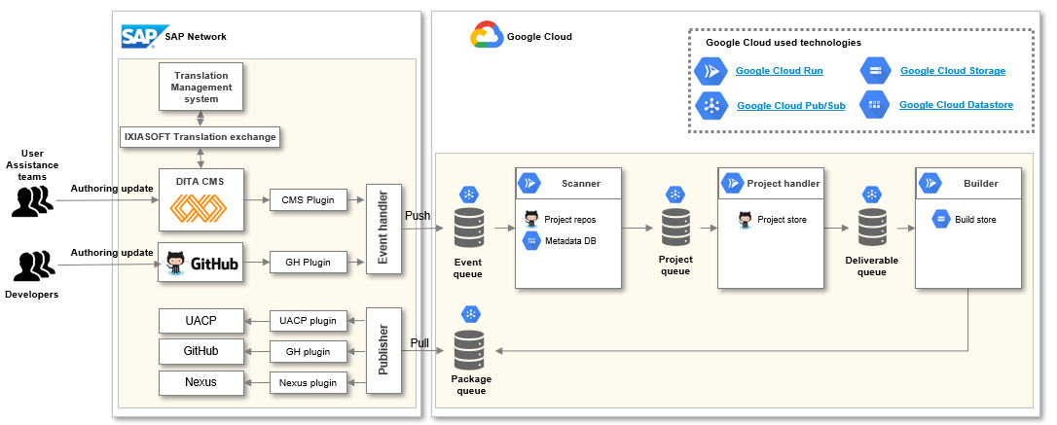
Executive summary
Homepage
Executive summary
Objective: Renovate DITA Build system to support growth (1 Million deliverable by 2021) and faster publishing cycles (50 % increase), to increase availability and resiliency and to reduce cost of operations and maintenance (~30%), leveraging Google Cloud offering
Motivation: Replace current proprietary, monolithic on premise build solution with modern, more scalable and flexible solution, also leading to higher cost efficiency
Key principles:
Managing the entire new Build system on the Cloud using GCP infrastructure leveraging on cloud-native technologies, fully managed infrastructure --> reduction of costs (after initial increase during transition phase)
Part of One Strike program, partnering with GCP/Multi-Cloud/GLDS for expertise --> lighthouse project for GLDS
Strategically replacing build components for scalability and flexibility in build processes, also making it independent of the content Management System and agnostic, supporting multiple CMSs (e.g. IXIASOFT, GitHub)
Architecture

Slide 15








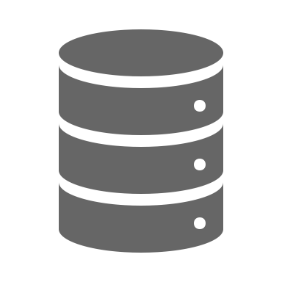




High-level architecture
Homepage
Micro-service architecture with loose coupling, asynchronous processes and message queuing
Serverless with fully managed infrastructure based on containerization from GCP public cloud - Frankfurt Region (Europe West 3)
Automated, incremental and scalable build process for documentation at deliverable level with elastic load-balancing
Standard and agnostic able to build multi-source documentation (e.g. DITA, Markdown) from various Content Management Systems (DITA CMS scenario, GitHub scenario)
Minimal security exposure and compliance: connection from SAP to GCP only (No link from GCP to SAP). Security concept and threat modeling performed
Cost effective: The day-to-day usage is based on a pay-per-use model
Translation Management system
IXIASOFT Translation exchange
SAP Network
Google Cloud
DITA Build Landscape
Authoring update
DITA CMS
Scanner
Project handler
Builder
CMS fetch
Push
Project repo
Project store
Build store
Authoring update
Metadata DB
GH Plugin
Event queue
Project queue
Deliverable queue
UACP
GitHub
Publisher
Pull
Nexus
Package queue
Google Cloud technologies
Google Cloud Run
Google Cloud Storage
Cloud Spanner
Google Cloud Pub/Sub
Google Cloud Build

Slide 16
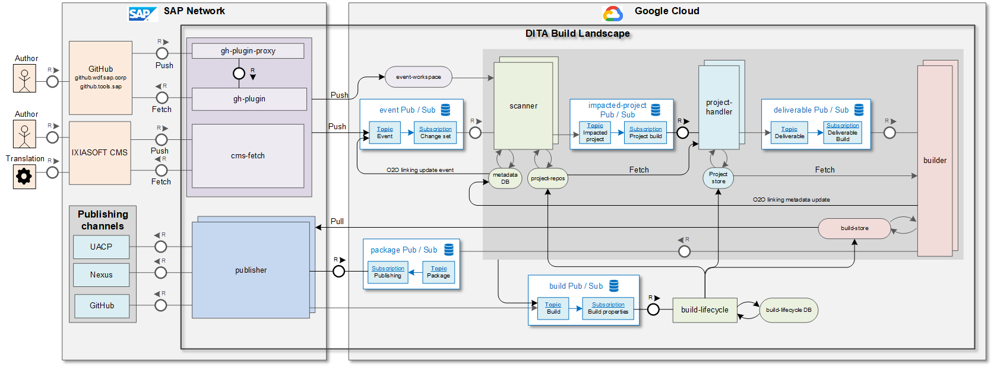
Detailed architecture (TAM)
Homepage
On premise component that handles GitHub webhook requests
SAPCFn component that fetches changes from GitHub and hand over to GCP
On premise component that fetches changes from DITA CMS and hand over to GCP with all needed metadata information
Scan source content to calculate dependencies to resources (data merge, feature flags …etc.)
Calculate impacted deliverables based on source and resource changes
Build impacted deliverables
SAPCFn component that handles the publishing to SAP delivery channels of produced deliverables
Update build lifecycle information on project and deliverable levels
Notes:
Subscription model:
.properties change when content change → We need them for topics, maps, images and projects
.customproperties → We need them for projects only

Slide 17
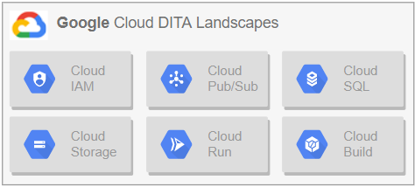
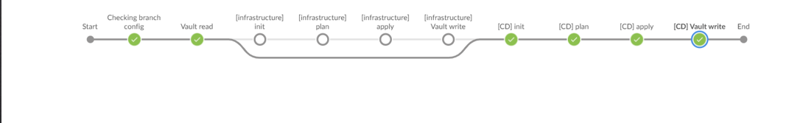





GCP Deployment pipeline
Homepage
See more...
Fully automated and SAP compliant pipeline supporting both Infrastructure and component deployment
Create from scratch a new build landscape in a new Google Cloud region with related GCP infrastructure and components using TERRAFORM, see more => Supporting Disaster Recovery (DR) scenario
Update an existing GCP build landscape from infrastructure and/or component deployment stand point using TERRAFORM, based on changes in GitHub => Supporting Infrastructure as a Code (IaaC) and Continuous Deployment principles
Pipeline based on standard SAP tools: Jenkins as a Service (JaaS), GitHub (GitHub branch reflecting GCP landscape configurations: prod, test, dev …)
Secure by design
Compliant with SAP security hardening rules for GCP, see more
GCP Infrastructure logs forwarded to the Central Security Information & Event Management (SIEM) solution for vulnerability detection , see more
“Least privilege” principle implemented: each microservice has its own service account (IAM) with ONLY the roles needed to access required resources
Credentials managed and stored in the recommended HashiCorp vault solution operated by SAP
Component container
…
Component container
Infrastructure deployment/update
Continuous Deployment of DITA components
JaaS
Artifactory
GitHub
Vault
Terraform
Terraform
Terraform
Vault
Terraform
Terraform
Terraform
Vault
Notes:
Subscription model:
.properties change when content change → We need them for topics, maps, images and projects
.customproperties → We need them for projects only

Slide 18
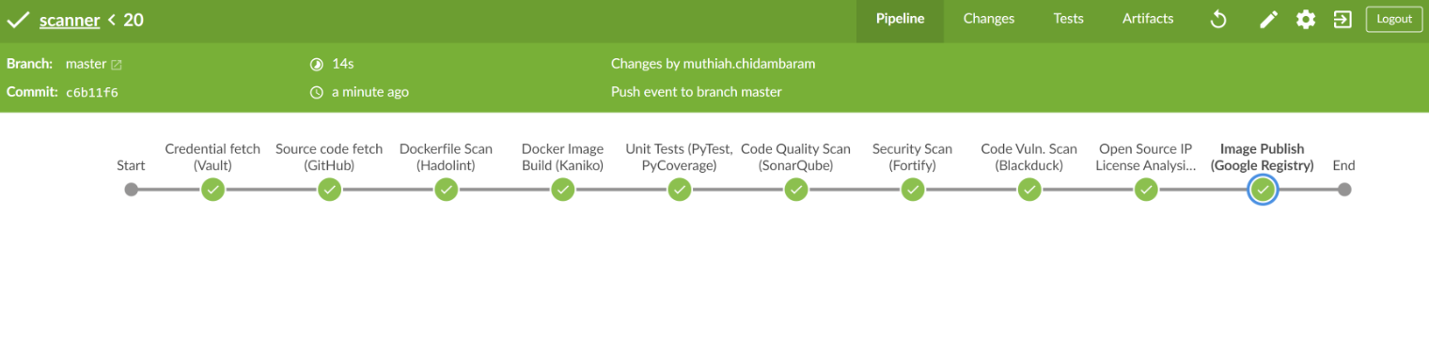








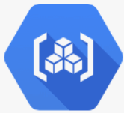
Development lifecycle pipeline
Homepage
Standard and secure development lifecycle pipeline created for each DITA component, based on hyperspace toolchain
Using Jenkins as a Service (JaaS) and Piper Lib (SAP pipeline orchestration library)
Created our own Jenkins Shared Library with a customized pipeline template tailored to DITA development (based on Docker & Python) and shared across all DITA pipelines
Storing credentials needed for JaaS pipelines in Hashicorp Vault
According to CI/CD principles for cloud development, each DITA component pipeline is implementing the stages below to build, test and detect quality, security and licensing issues for each source code change submitted through the GitHub repository.
JaaS
Piper
Vault
GitHub
Hadolint
Kaniko
PyTest
SonarQube
Fortify
Black Duck Binary Analysis (for Dockers)
WhiteSource
Google Artifact Registry
See more...

Slide 19


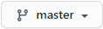
Release Process from Source to Production
Homepage
Using Development pipeline for Continuous Integration / Continuous Delivery and Deployment pipeline for continuous deployment
GCP sap-dita-prod landscape
Registry
Run-time
GCP sap-dita-test landscape
GCP sap-dita-dev landscape
Registry
Run-time
Registry
Run-time
❹
scanner
❷
❶
Development pipeline
Deployment pipeline
❸
Infra=n | CD=y
Development pipeline
Deployment pipeline
Deployment pipeline
Infra=y | CD=y
Accept/reject
Infra=y | CD=y
Actions from component source change to prod landscape
❶ Make a change to a microservice component in sap-dita-dev branch => Change validated and deployed to sap-dita-dev landscape
❷ Validate the change in sap-dita-dev landscape (manual, automated acceptance)
❸ Push change to master branch => Change validated and deployed to sap-dita-test landscape
❹ Validate the change in sap-dita-test landscape and trigger deployment to sap-dita-prod landscape if successful tests

Slide 20
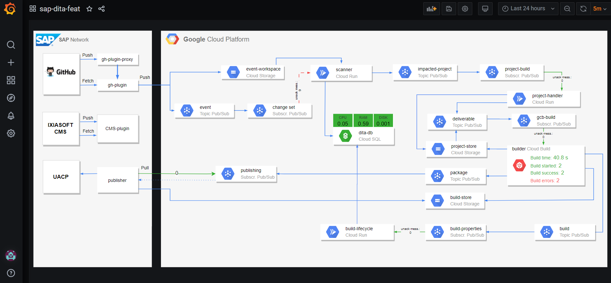
Infrastructure Monitoring – Grafana dashboard
Homepage
Notes:
Subscription model:
.properties change when content change → We need them for topics, maps, images and projects
.customproperties → We need them for projects only

Slide 21
High-level SLAs from Ops & Support perspective
Homepage
Google supports 24x7 GCP DITA landscape infrastructure
GLDS (Global Labs Development Systems) supports 24x7 Sideras DITA landscape infrastructure
Our team provides 5x8 Development support
GLDS (Global Labs Development Systems) manages user management : dealing with MC team to create new users (CAM requests)
GLDS does 24x7 monitoring of Grafana dashboards (GCP, Sideras) and Slack channels and fixing issues Pre-requisites:
Define recommended actions/procedures when thresholds are reached and actions how to fix them. Actions are described in Grafana alerts.
Provide access to Grafana dashboard and GCP stackdriver to GLDS
Define how GLDS will contact our team, in case of errors in our software,
Train GLDS how to perform a rollback on a software component deployed to PROD to previous PROD version
Define clear criteria when a rollback on a software component should be done
Ensure that GLDS is trained on GCP support process
Define process to blacklist some requests that are putting down the system in an unexpected way (e.g. more than a certain build requests in a time-frame)
Notes:
Subscription model:
.properties change when content change → We need them for topics, maps, images and projects
.customproperties → We need them for projects only

Slide 22
Key Metadata concepts
Homepage
Content Management System
Scanner (Source changes)
Project Handler (Project)
Builder (Output)
Publisher (Package)
Delivery channels
IXIASOFT
New build revision
New build revision
New build revision
DITA CMS
scenario
DITA Source
Source changes
DITA Source by project
Output & logs
Package
Metadata.xml
Project Map
Meta data DB
BOM
BOM
BOM
GitHub
New build revision
New build revision
New build revision
GitHub
scenario
Markdown Source
Markdown Source by Repo
Output & logs
Package
Metadata.xml
Metadata Repo
BOM
BOM
BOM
Source & deliverables
Meta Data

Slide 23
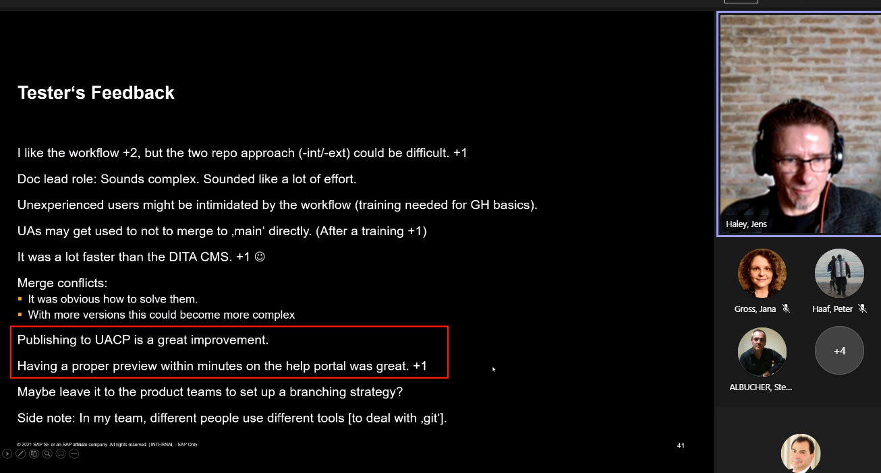
1st GitHub piloting feedback
Homepage

Slide 24
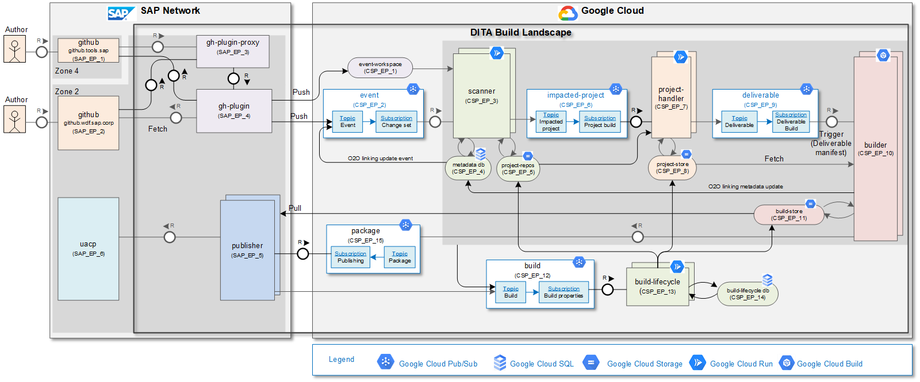
Detailed architecture (TAM) – GitHub scenario
Homepage
Visio document - version: 3.5GH
Notes:
Subscription model:
.properties change when content change → We need them for topics, maps, images and projects
.customproperties → We need them for projects only

Slide 25
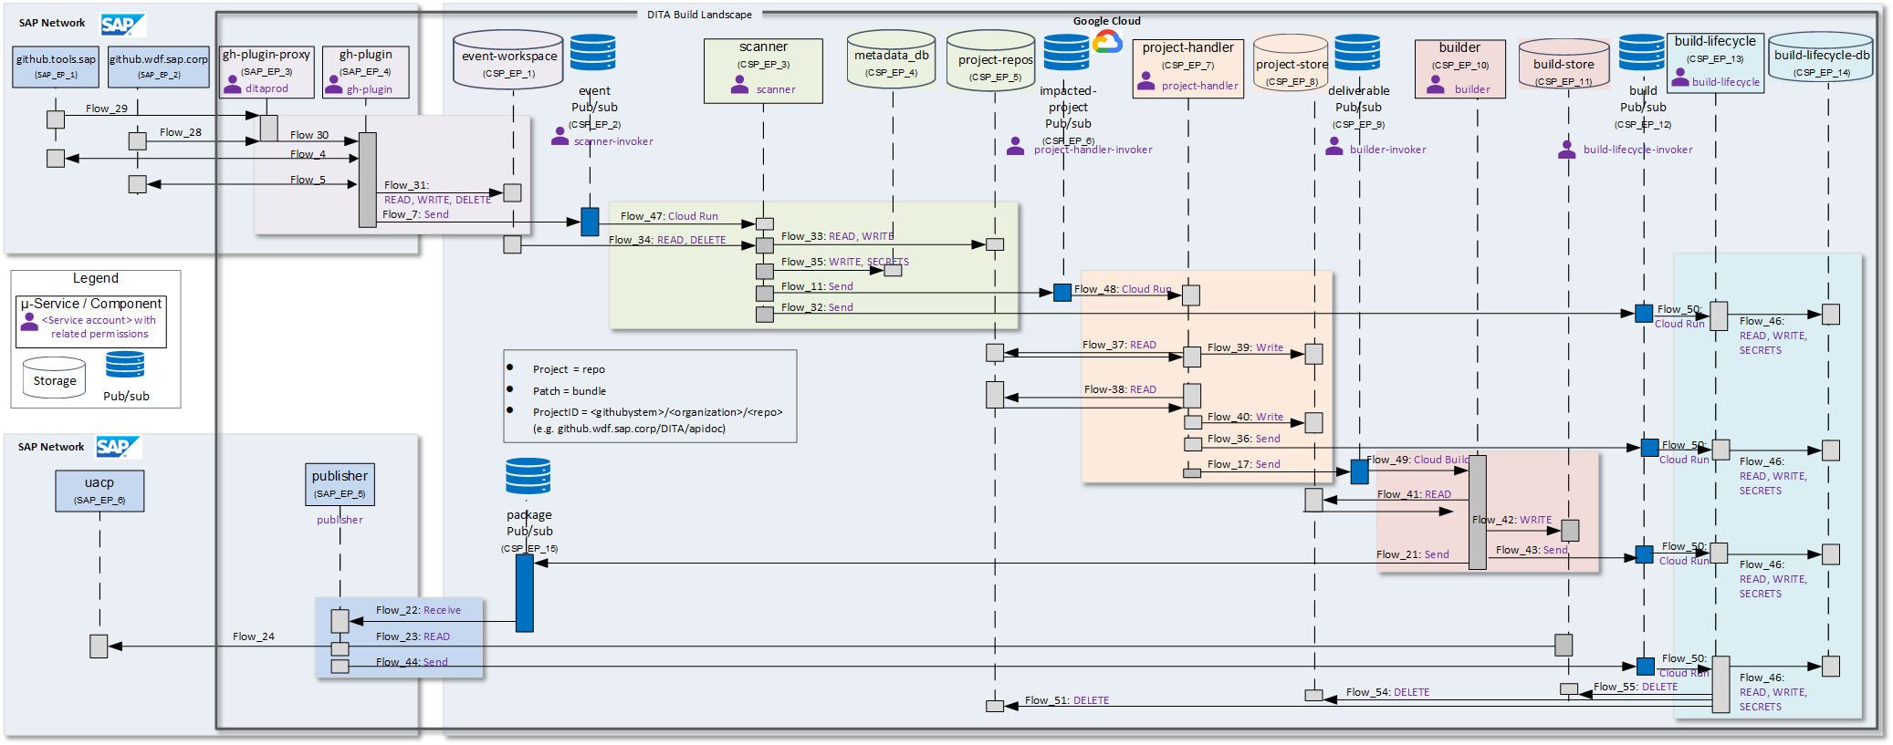
Detailed architecture (Sequence) - GitHub scenario
Homepage
Visio document - version: GH 3.4 Flows
Notes:
Subscription model:
.properties change when content change → We need them for topics, maps, images and projects
.customproperties → We need them for projects only

Slide 26
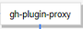



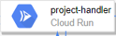


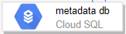
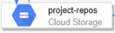
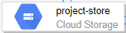
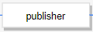

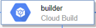
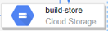
Detailed architecture (Landscape flow) - GitHub scenario
Homepage
GitHub Repo (prod)
Webhook: <URL>/landscape=sap-dita-prod
GitHub Repo (feat)
Webhook: <URL>/landscape=sap-dita-feat
sap-dita-prod
sap-dita-feat
Sideras env.: sap-dita-prod
GCP project landscape : sap-dita-prod
Sideras env.: sap-dita-feat
GCP project landscape : sap-dita-feat
Push
UACP
Pull
Notes:
Subscription model:
.properties change when content change → We need them for topics, maps, images and projects
.customproperties → We need them for projects only

Slide 27
DITA CMS Migration to Converged Cloud
Homepage

Slide 28
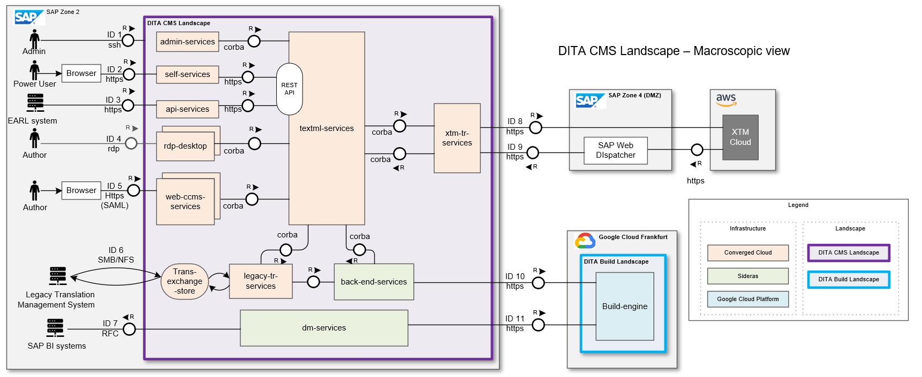
Back to home page

Slide 29
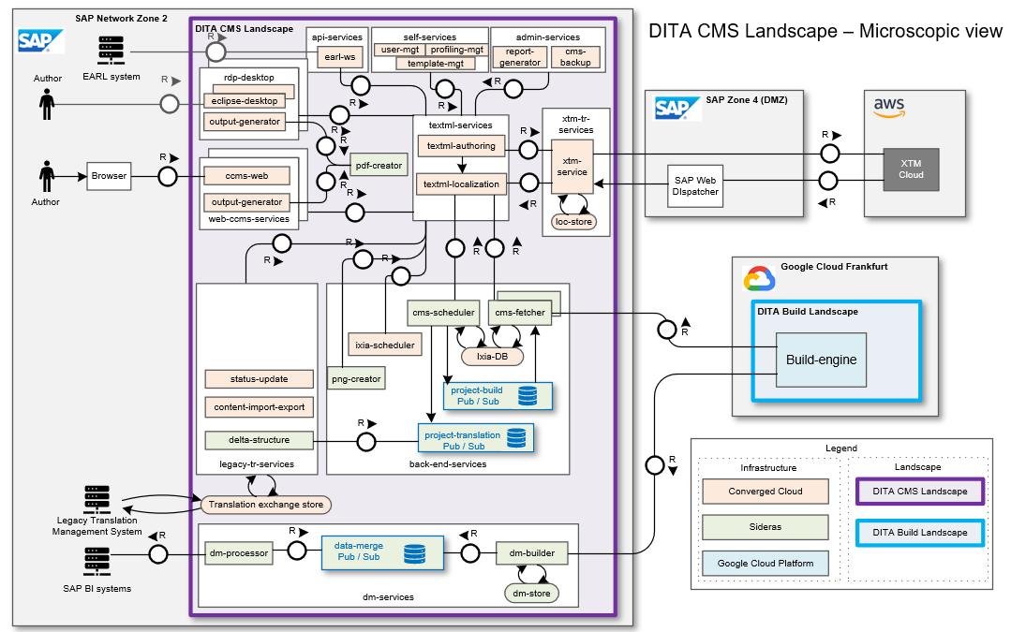
Back to home page

Slide 30
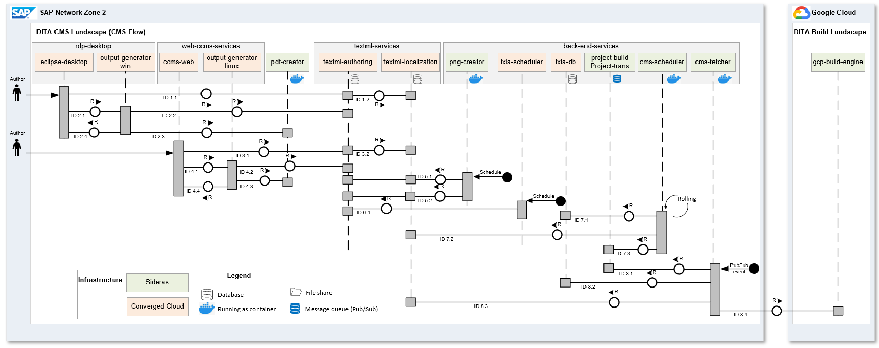
DITA CMS Landscape | Sequence diagram – CMS Flow
Back to home page

Slide 31
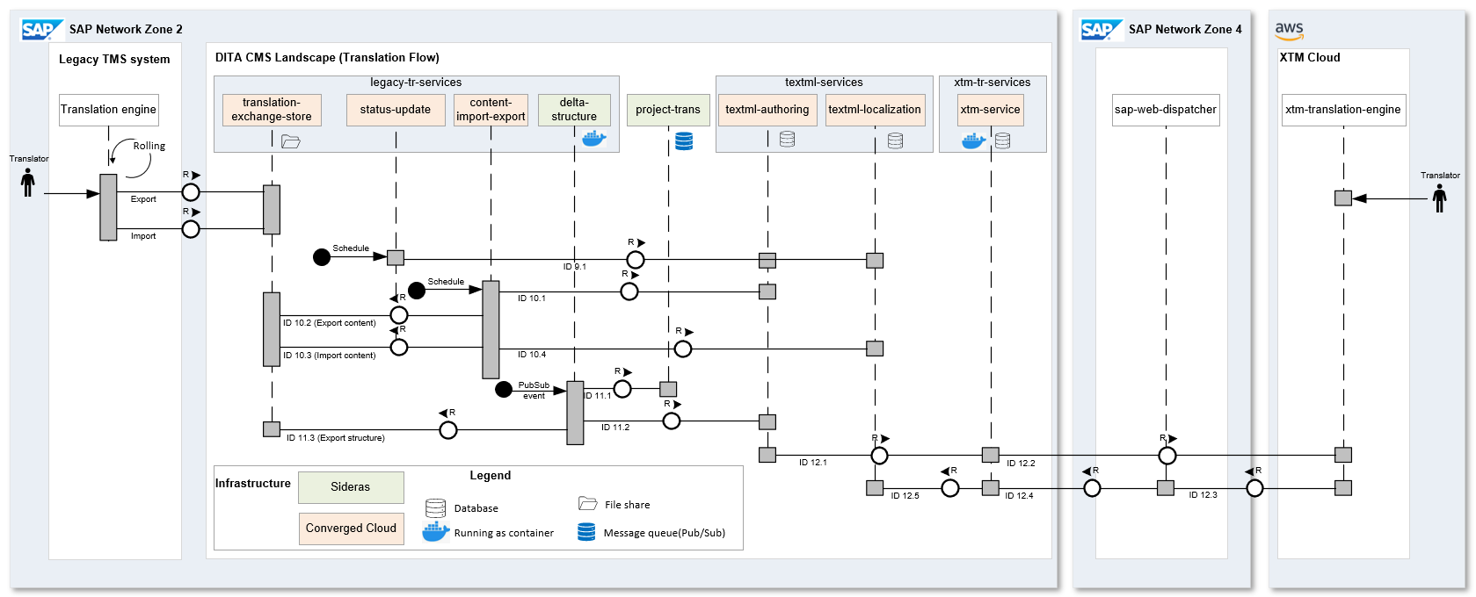
DITA CMS Landscape | Sequence diagram – Translation Flow
Back to home page

Slide 32
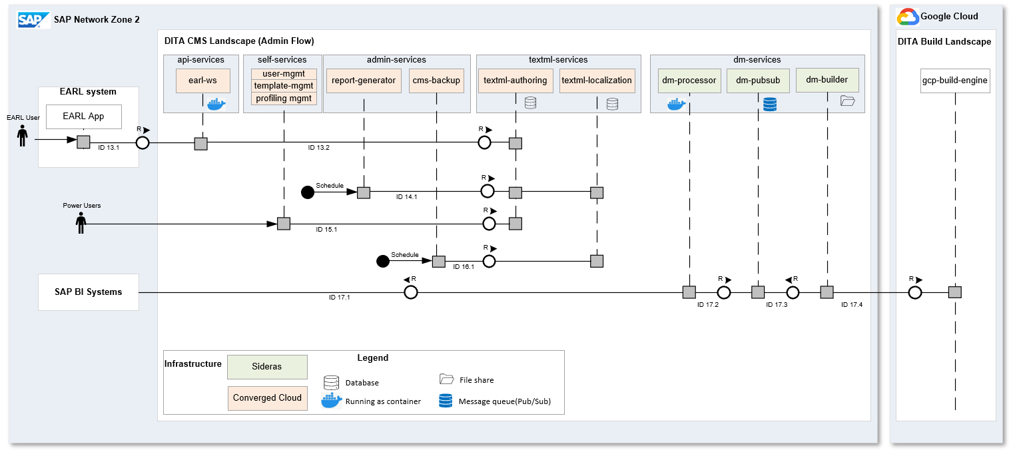
DITA CMS Landscape | Sequence diagram – Admin Flow
Back to home page

Slide 33
Current SAP DITA Landscape
Homepage

Slide 34

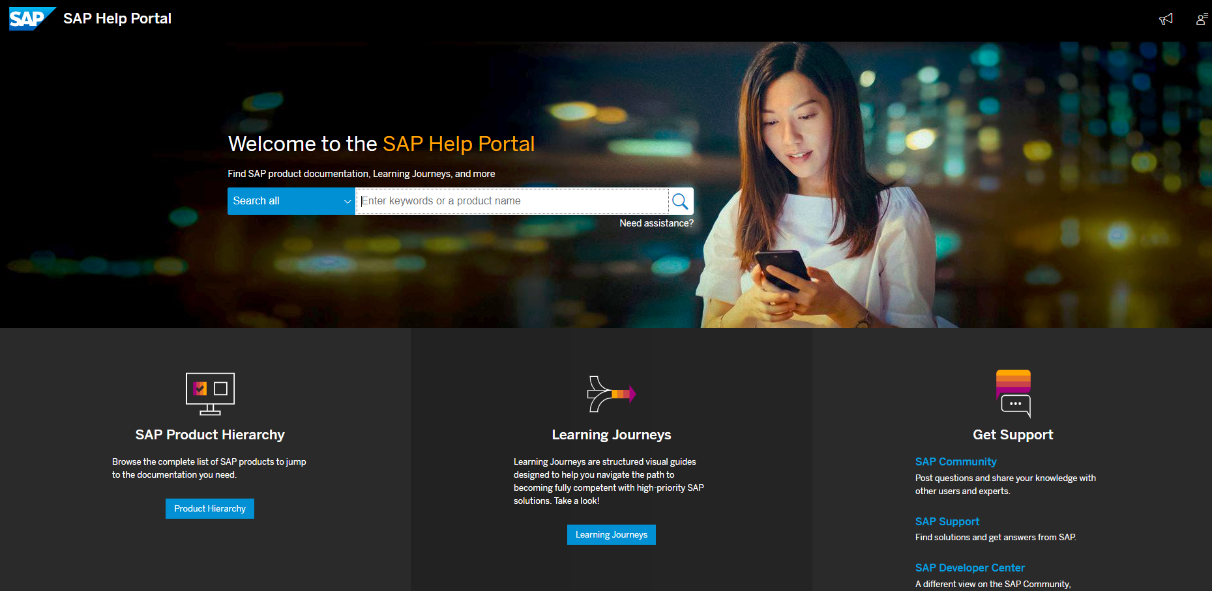

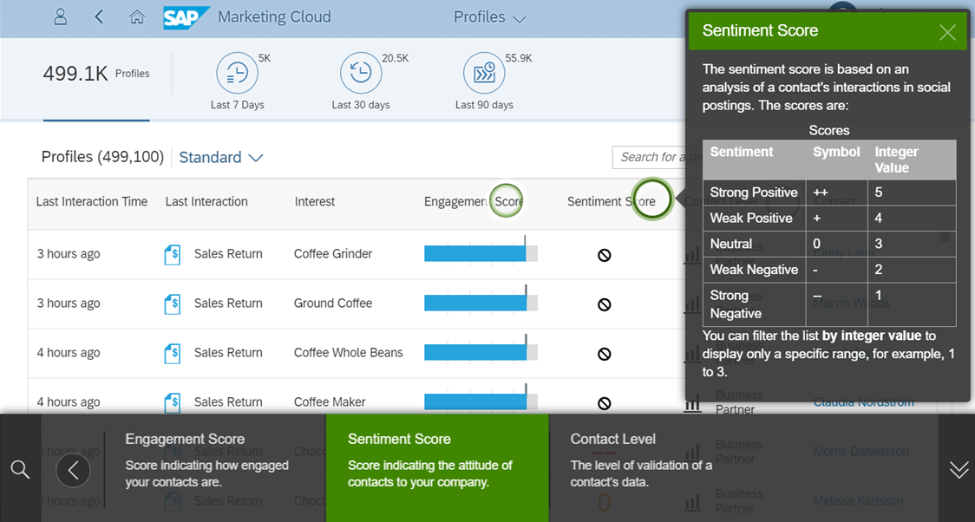
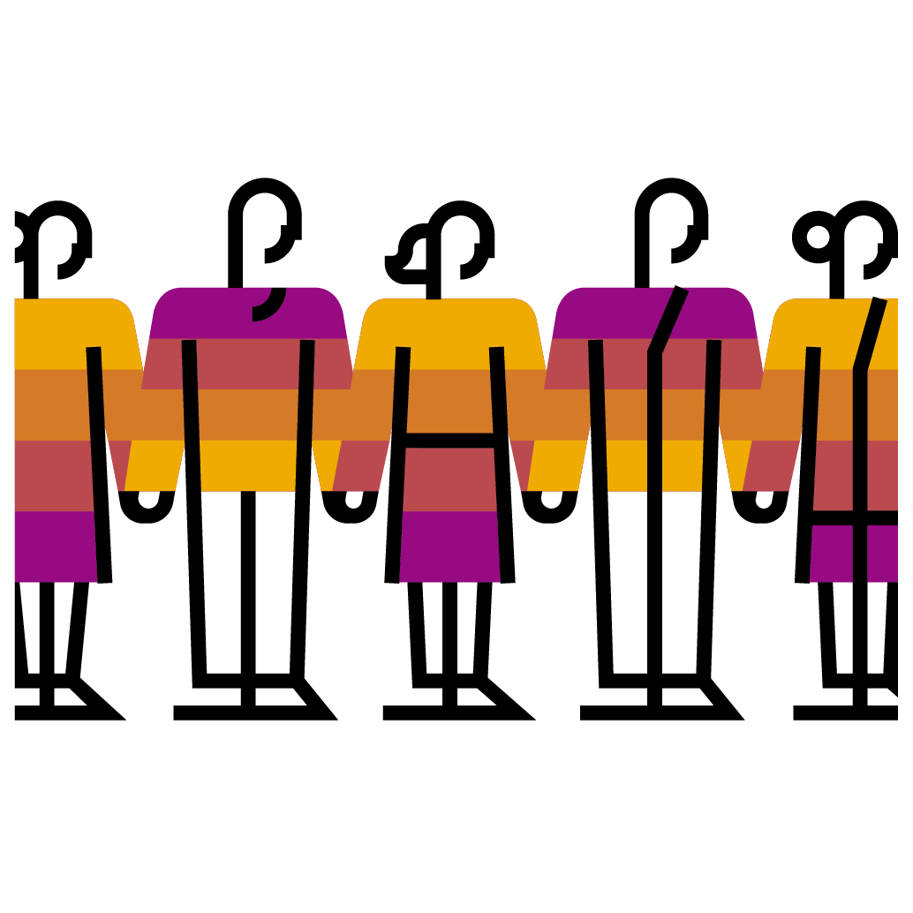
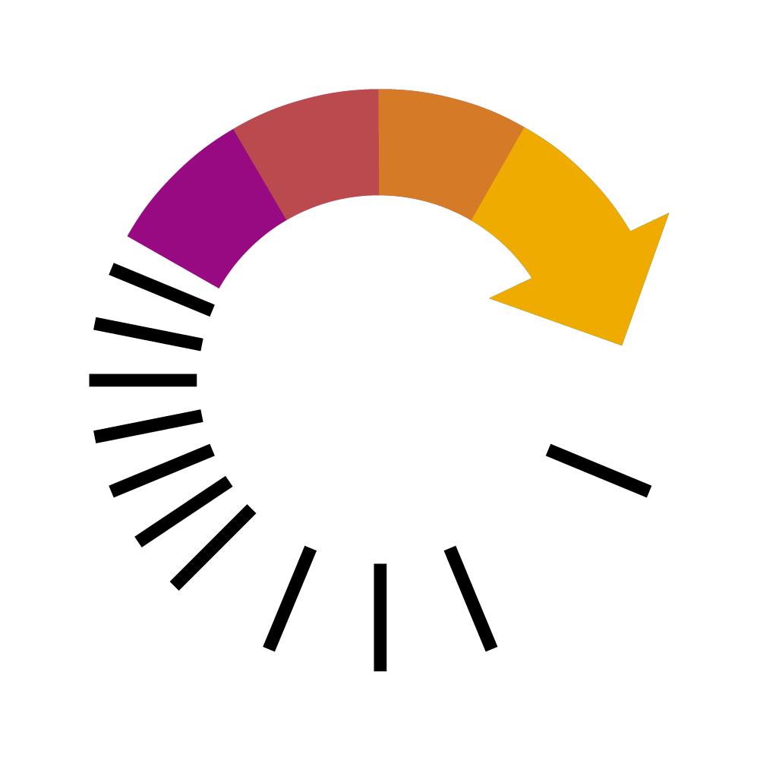


SAP DITA Landscape - Executive summary
Homepage
A best-in-class Content Management landscape enabling User Assistance (UA)* teams to develop and deliver product documentation to customers
Large-scale and Integrated infrastructure managing source and localized content in DITA with Build and Publishing
Integration with translation system
Production of multi-format and multi-language deliverables
Publishing to web and Software embedded channels
>2600 users | >7.8 Million files in DITA CMS | 51 languages | ~600 000 deliverables
Web channels
help.sap.com
Innovation platform enabling extensible content creation and reuse based on
Industry-leading CMS (IXIASOFT),
Industry standards (DITA, DITA Open Toolkit), and open source components
In-app help
DITA Landscape
DITA CMS System
DITA Build
Authoring | Localization | Versioning | Delivery
Multi-format | Multi-channel
Agile and automation with CI/CD processes enabling products to ship multiple times a day, including translation
Fully automated production pipeline with high-quality service, allowing continuous production cycles 24/7
Multiple production cycles a day from source to publication
UA Teams (*)
Software embedded channels
Translation environment
(*) Groups beyond UA also use the system: e.g. Learning Journeys

Slide 35

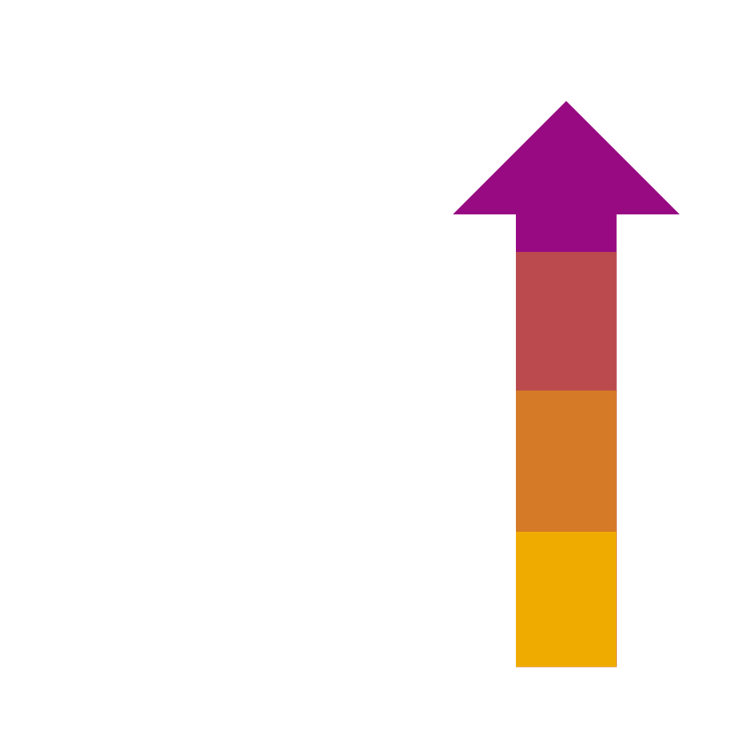



SAP DITA Landscape - Our situation today
Homepage
~2600
registered CMS users (~1400 active)
7.8
4430
million DITA files (down from 9.1 after archiving)
projects (down from 11379 after archiving)
Constant, aggressive content growth (brand-new or migrated) requires constant performance focus and large-scale rearchitecting
50+
~600k
languages
deliverables

Slide 36
SAP DITA landscape - Functional components
Homepage
SAP + Non-SAP
M
Monitored
Exclusively SAP
DITA Landscape
DITA CMS front ends
DITA Build
Delivery channels
Browser
Eclipse RDP
SAP DITA Build Framework
Production plugins: production center, build dashboard, project map editor …
DITA Output framework
DITA OT customization
Internal Help Portal
IXIASOFT CCMS Web
Oxygen customizations
DITA Open Toolkit
Antenna House
Deliverables
IXIASOFT extensions
Schematron
~4 times a day
on demand
Acrolinx
Oxygen editor
DITA Build system
& scheduling
IXIASOFT DITA Eclipse
M
RDP Infrastructure (DC, storage, servers, remote access)
Build Infrastructure (DC, build servers, logistic servers)
…
M
M
DITA CMS back-end
M
M
M
M
M
M
IXIASOFT CCMS Web server
Output Generator server
Cloning scheduler
PNG creation
M
Delta fetch
Translation exchange
Content
Translation system
Hourly
M
M
TEXTML authoring Connection, replication, document base, configuration, DTD …
Replication
TEXTML Localization translation, build, backup …
Structure
M
~4 times a day
Back-end infrastructure (DC, Storage, cluster, servers, failover …)

Slide 37
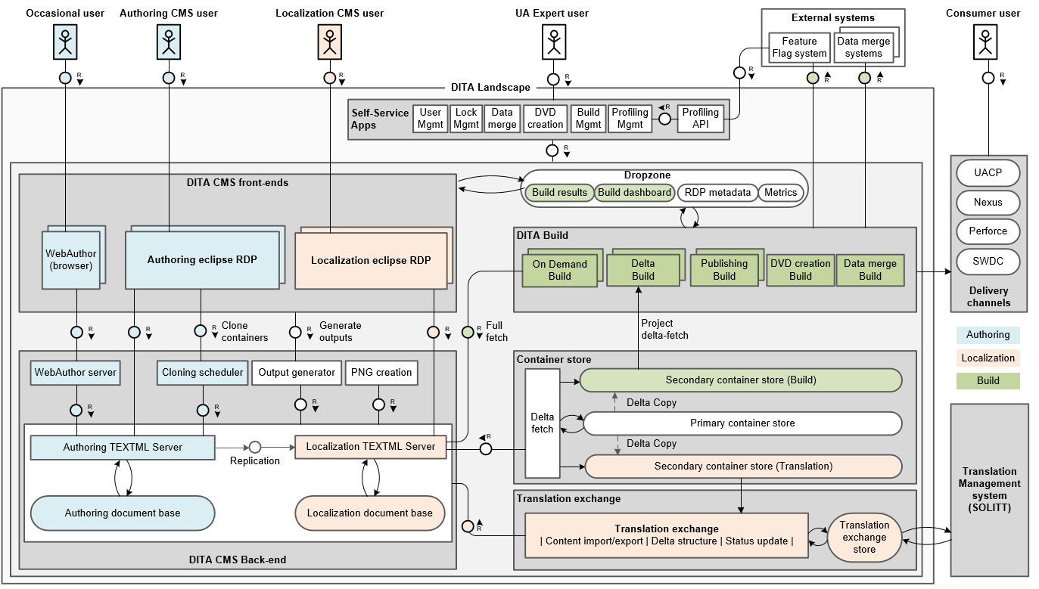
SAP DITA Landscape - Architecture
Homepage

Slide 38

SAP DITA landscape - DITA build process
Homepage
Build process overview
Builds are triggered automatically (~4 times a day) when content is changed in the CMS (rolling delta builds)
Authors can also trigger builds manually (on demand builds)
Key build capabilities
Single source, multiple formats, multi-language
High volume / scalability production
Delta build architecture (rolling build cycles)
Profiling and feature flags support
Dynamic content injection from other internal systems (data merge)
Key output capabilities
SAP-branded outputs (~20 formats)
Sophisticated linking required for Intelligent Enterprise integration
Outputs adapted for consumption by software products (e.g. Web Assistant)
DITA Landscape
DITA CMS system
DITA Build system
On Demand Builds
Full pre-publish
Full build
…
Full build
Rolling Delta Builds
DITA CMS back-end Authoring
Delta Build.1
Delta Build 2
Delta Build 3
…
Delta Build n
Delta compilation
DITA CMS Front-end
DITA CMS back-end Localization
Full fetch
Container Store
Delivery channels
Authoring update
Delta fetch
Project fetch (Delta)
Delta publish
Delta structural data
Rolling Build cycle
Translation exchange
Translation Management system
Notes:
The container store is a DITA CMS extension to enable delta builds. It is updated multiple times a day from the DITA CMS through a rolling delta fetch process

Slide 39
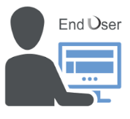
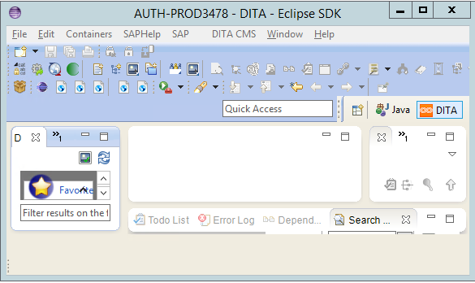
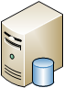
SAP DITA landscape - End-to-End pipeline from source to delivery
Homepage
Principles
A delta build is assigned to a build server to enable delta mode
A delta build detects new changes in the container store (since the previous build revision) then produce and pre-publish only impacted outputs
Each build server is running its rolling build cycle (sequential Delta builds). See build cycle report
Each build has it’s own execution status. See Build execution report
Benefits
Build only changed outputs → Faster builds
Multiple build cycles per day → Faster validation & delivery
Pre-publish only changed outputs → Load reduction to delivery channels
Optimize hardware / Build resources → TCO reduction & cost saving
Remote access infra. & CMS front-end
CMS Back-end Infra (TEXTML PROD cluster)
Container Store infrastructure (Primary & secondaries)
Build Infrastructure (Build server pool)
Delivery channels
DITA CMS Front-end
DITA CMS back-end Authoring
DITA CMS back-end Localization
Primary container Store Server
Secondary container Store Server (Build)
Build Server
Delta Build 1
Delta Build 2
Delta Build 3
…
Delta Build n
6
7
New change
Immediate Replication
Rolling Delta fetch
Delta copy
Project Delta fetch
Delta publish
UACP
1
User workspaces
Rolling Build cycle
2
3
4
5
Nexus
Authoring docbase
Localization docbase
Secondary container Store Server (Translation)
GitHub
Rolling Delta translation structure
Translation Exchange Store
…
RDP Servers
Build Servers
Translation Management system
Build status
nothing to do
Completed
In progress
Waiting

Slide 40

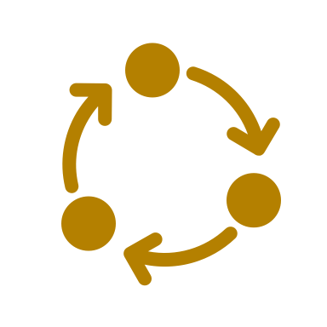
SAP DITA landscape - End-to-End pipeline from source to delivery
Homepage
Master pipeline
Authoring
CMS Back-end
Delta fetch
Translation exchange
Delta Build
Delivery channel
Authoring actions on CMS front-end
Instant docbase replication authoring -> localization
Container Store Rolling cycle
Translation exchange Rolling cycle
Build cycle start
Delta Build 3
…
Delta Build n
Delta Build.1
Delta Build 2
Publishing (by Delivery channel)
Sub pipelines
Lock
Handle requests
CMS delta fetch
Project structure
Publish output
Rolling build cycle (by build server)
Update
Replicate docbase
Project metadata
Content export
…
Release
Project dependencies
Content import
…
Update secondary CS Buid
Clean workspace
Update secondary CS Translation
Fetch sources
Quality check
Merge Data
Delta Build status
Scan source & dependencies
nothing to do
Completed
Calculate impacted outputs
In progress
Fetch build tools
Waiting
Build impacted outputs
Export impacted outputs
Finalize build

Slide 41
SAP DITA landscape - Current DITA Build solution limitations & paint points
Homepage
Projects to build
Pool of Build servers
30%
Proprietary on premise Build solution with monolith architecture (Container store, Build)
Static assignment of projects to build servers resulting into
Non optimal resource utilization rate
Waiting list on projects (build cycle): A large project can become a bottleneck
High cost operations
The container Store is a bottleneck to run a true CI/CD on project level
Build server
Small
Medium
Assignment of projects to Buid servers
Large
Project
Deliverable
Deliverable to build
Notes:
The current Build solution has the following shortcomings that limit the scalability and TCO reduction
Static assignment of projects to Build servers
Build resource consumption is optimized per Build server, without having the possibility to do it on the whole infrastructure
The waiting list is organized by project within a Build server. A "large" project in the Build cycle can become a bottleneck for projects in the waiting list

Slide 42
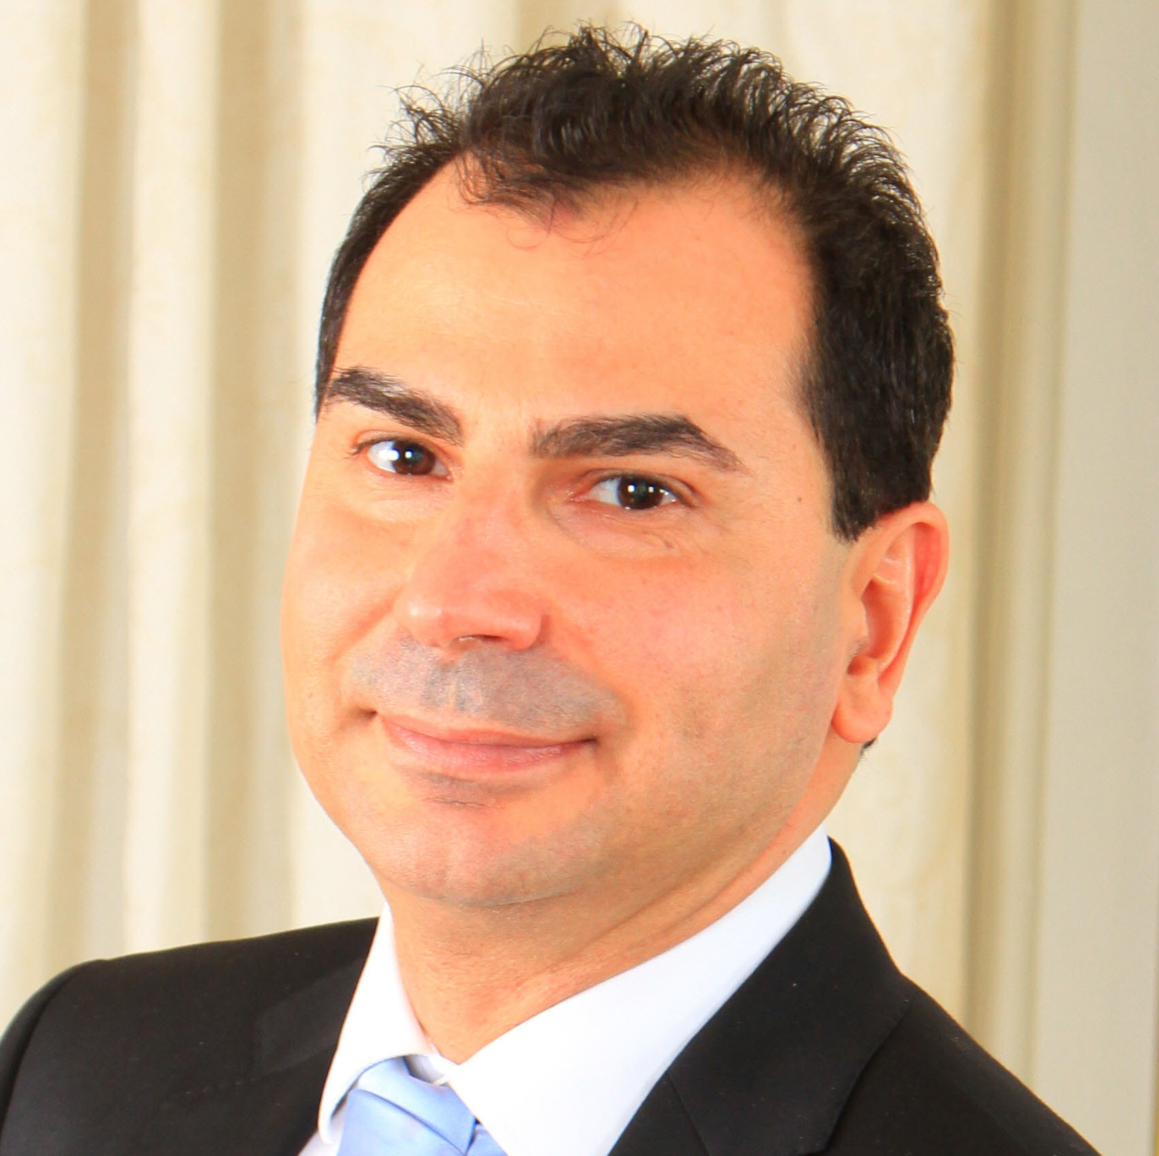

Thank you
Youssef Bennani
Youssef.bennani@sap.com

